Slide 1
White title slide
Thank you for joining us for today’s webinar:
Improving Financial Security for People with Disabilities through ABLE Accounts
The webinar will begin promptly at Noon CT

Slide 2
Text slide: 1 column
Improving Financial Security for People with Disabilities through ABLE Accounts
December 3, 2024, Noon – 1 pm CT Brought to you by:
Retirement and Disability Research Center at the
University of Wisconsin - Madison

Slide 3
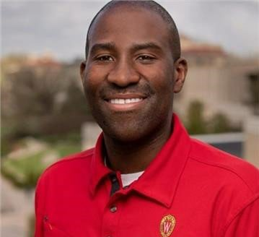
Text slide: 2 column
Improving Financial Security for People with Disabilities through ABLE Accounts
Welcome & Introduction
Presentations:
Research Overview
Policy & Practice Implications
Questions & Answers
Sign Off
Jonathon Ferguson Financial Capability Specialist
University of Wisconsin-Madison

Slide 4
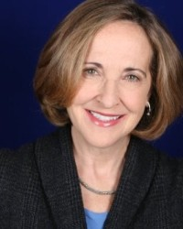
Text slide: 2 column
Our Presenters
Dr. Mike Levere
JJ Hanley

Slide 5
Text slide
Research Overview
Improving Financial Security for People with Disabilities through ABLE Accounts
Improving Financial Security for People with Disabilities: The Promise of ABLE Accounts
Guglielmo Briscese (University of Chicago Inclusive Economy Lab)
Mike Levere (Colgate University)
Harold Pollack (University of Chicago)

Slide 6
This research was supported by a grant from the U.S. Social Security Administration (SSA) as part of the Retirement and Disability Research Consortium (RDRC). The findings and conclusions are solely those of the authors and do not represent the views of SSA, any agency of the federal government, the Office of the Illinois State Treasurer, or the University of Wisconsin-Madison Center for Financial Security.

Slide 7
Financial security for people with disabilities
Managing a disability demands substantial resources, leading to lower rates of financial security (Morris et al. 2021; Warren et al. 2023)
Particular challenges for those who rely on Supplemental Security Income (SSI) benefits
$2,000 resource limit for individuals hinders saving and investments
Limit last raised in 1989, though recent bipartisan proposal to raise to $10,000 and index for inflation

Slide 8
ABLE accounts can help people living with a disability to gain financial independence
Eligibility: has significant disability with age of onset prior to 26
For SSI recipients, up to $100,000 exempt from the $2,000 resource limit
Savings can be spent on a broad range of qualified disability expenses
Despite its advantages, low take-up rates nationally
About 1 percent of SSI recipients have an account (Weathers, Kelly, Hemmeter 2021)
Nationally, 7 percent of people with disabilities have heard of ABLE (Warren et al. 2023)
46 states and Washington DC offer ABLE programs

Slide 9
Research question
What are the key barriers to take-up of ABLE accounts?
Financial constraints
Might not be worth signing up if lack ability to save and contribute
Learning costs
Can’t sign up if don’t know about the program
Compliance costs
Enrollment process may be perceived as complicated or be misunderstood to potentially affect other benefits

Slide 10
Overview of approach
Analyze ABLE administrative data: 6,864 accounts opened through end of February 2024
Analyze ILSTO 2022 survey: 2,515 responded about their awareness, interest, and participation in the program
Seeding initiative: offer $100 account seeding to people who completed a brief survey and opened an IL ABLE account
Monitored account usage over a period of five months
Conducted follow-up survey five-months after accounts opened
Conducted qualitative interviews

Slide 11
Overview of findings
Financial constraints, learning costs, and compliance costs all contributed to limited ABLE take-up
Challenges in getting people to sign up even with seeding opportunity: only 40 accounts seeded (intended to seed 400 accounts)
New account owners contributed to their accounts: average = $1,236 / median = $150
30 percent withdrew money
Among those who withdrew, average = $480 / median = $184

Slide 12
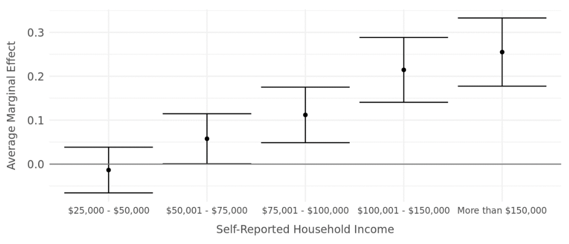
Large socioeconomic gradient in take-up of ABLE accounts
The graph shows the average marginal effects of a logistic regression where the outcome variable is an indicator for if the ILSTO 2022 survey respondent reported owning an ABLE account.
Notes:
Note see this in a map too – accounts more heavily concentrated in higher income zip codes; The top 12.3 percent of accounts in Illinois hold fully half of the state’s total ABLE financial assets, while the bottom 50 percent of accounts contain less than nine percent of Illinois’ total ABLE account assets.

Slide 13
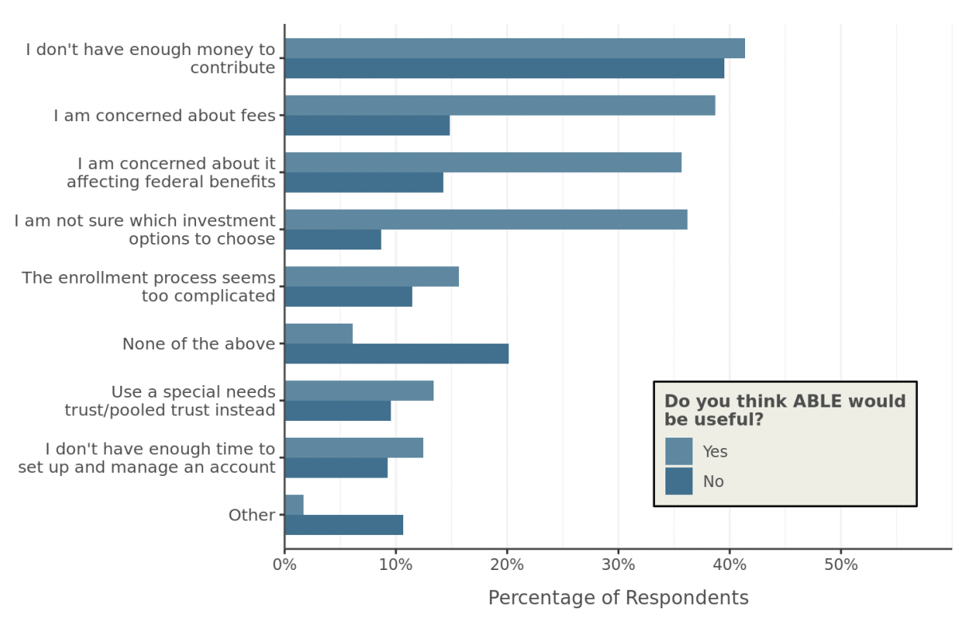
Financial constraints likely limit program participation
The graph shows the percentage of ILSTO 2022 survey respondents, n=1,776 respondents, who did not already own an ABLE account, of whom 1,419 said ABLE would be useful and 357 said that ABLE would not be useful.
Notes:
People’s limited income and resources were the most widely cited barrier to opening ABLE accounts. Particularly important challenge for SSI recipients

Slide 14
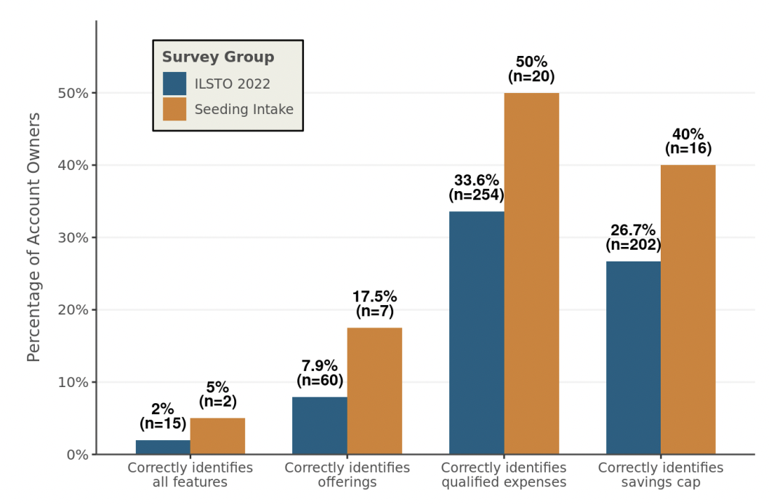
Knowledge of ABLE accounts is low and understanding of program requirements is limited
Fewer than half of ILSTO survey respondents had heard of ABLE
Survey likely included many with disabilities who were not eligible for ABLE.
9 of 40 new account owners first heard of ABLE through study recruitment
Notes:
Learning costs!

Slide 15
Perceived program complexities and concerns it may affect other benefits
Heard through surveys and qualitative interviews that a top concern was an ABLE account might affect other benefits
Likely misplaced given rules exempting money in ABLE from SSI and Medicaid resource limits
Consistent with rule misunderstanding
Some also cite perceived complexities
Enrollment process
Difficulty selecting an investment plan
Notes:
Compliance costs! Particularly note that for those who ended up opening, it was key that it not affect other benefits (35 of 40 cited)

Slide 16
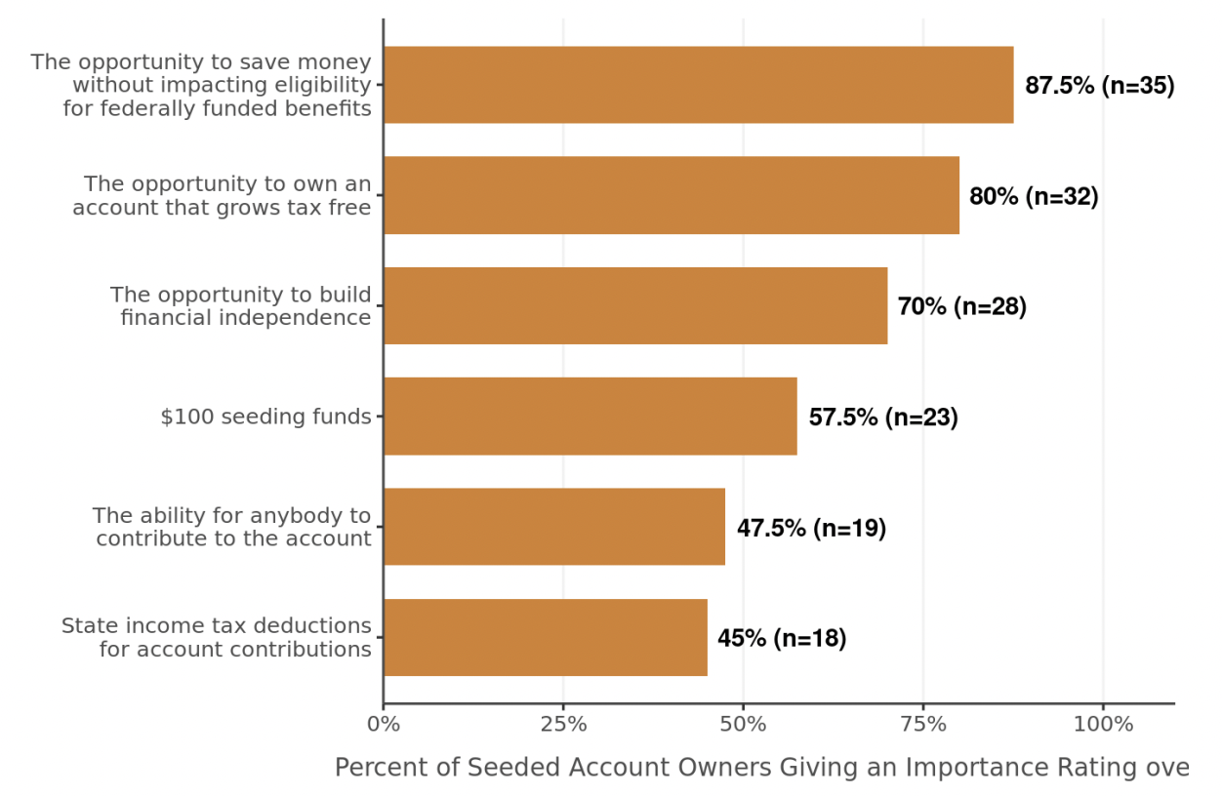
Seeding pilot
Extensive outreach efforts, but substantial challenges in getting enrollment (only 40 new accounts)
Survey responses consistent with role of financial constraints, learning costs, and compliance costs in preventing account opening
Figure shows percent of new account owners rating each item 7 or higher (out of 10 point scale)

Slide 17
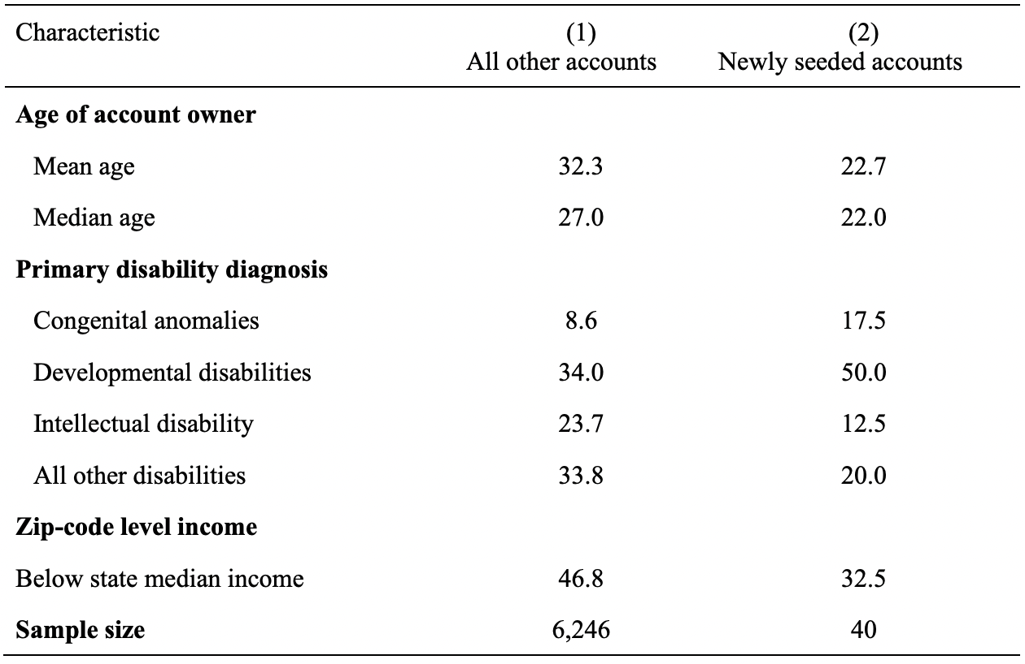
New account owners younger, from wealthier areas than existing owners
Summary statistics use ILSTO administrative data.

Slide 18
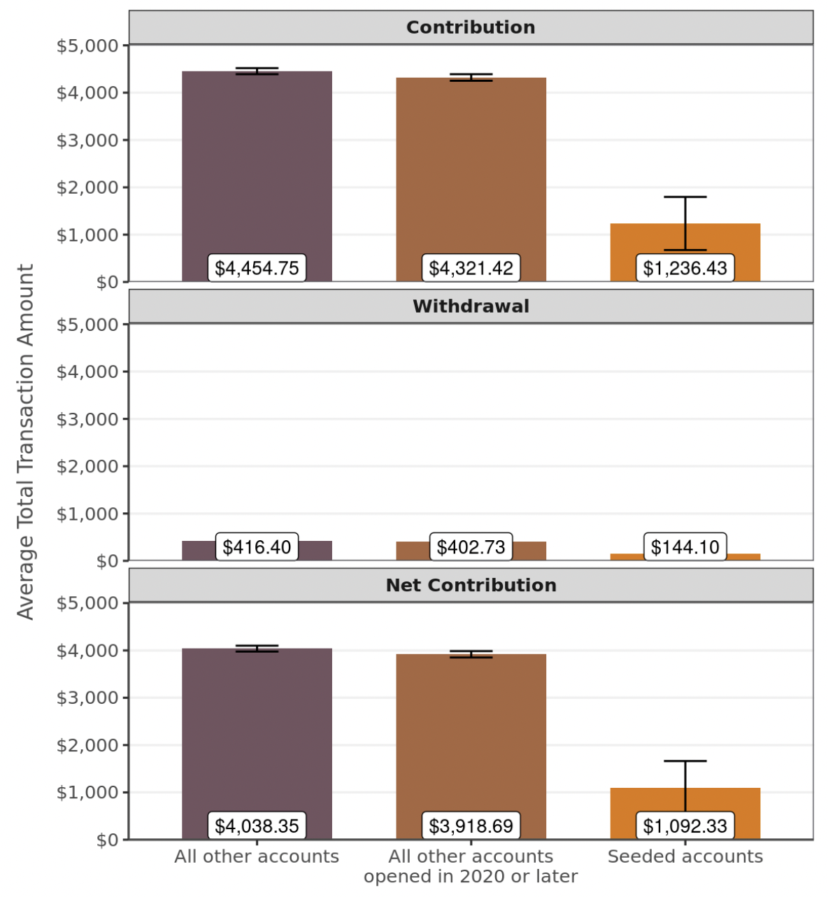
Newly seeded account owners contribute and use account less than existing owners
Shows contributions and withdrawals over 5 months after account opening

Slide 19
Upcoming RCT will generate more rigorous evidence on barriers
Working with SSA to recruit ABLE-eligible SSI recipients in Illinois and Michigan to participate in an ABLE study
Some excluded: e.g., must be working age, not have organizational rep payee
Three phased RCT designed to address each barrier:
Learning costs: treatment is an outreach letter confirming eligible to open an account
Compliance costs: treatment is a $250 account seeding
Financial constraints: treatment is $1:$1 matching up to $500
Planned launch: early March 2025
Analyze impacts in survey and administrative data
ABLE account opening and usage of accounts (through ABLE data)
SSI participation (through SSA data)
Annual earnings (through IRS data)
Surveys designed to help understand mechanisms for impacts (or lack thereof)
Potentially important subgroup by age of SSI receipt
Notes:
Reiterate quick summary – all barriers play a role. Limited take-up through pilot.

Slide 20
Text slide
Policy & Practice:
Improving Financial Security for People with Disabilities through ABLE Accounts
ABLE Plan Highlights
Eligible person with the disability is always the Account Owner and beneficiary
SSI benefits preserved up to $100,000 in ABLE Account balance
Assets in ABLE Account are not counted toward assets limits set by Medicaid and HUD
Anyone can contribute to an ABLE Account (owner, friends, family)
Earnings and withdrawals are tax-free if used for Qualified Disability Expenses (QDEs)

Slide 21
Text slide
Policy & Practice:
Improving Financial Security for People with Disabilities through ABLE Accounts
ABLE Plan Highlights
QDEs are expenses that maintain or improve the health, independence and/or quality of life of the Account Owner
Some state plans offer additional tax benefits
Maximum aggregate annual contribution $18,000 ($19,000 beg 2025)
Possibly more if Account Owner works
One Account per owner nationwide

Slide 22
Text slide
Policy & Practice:
Improving Financial Security for People with Disabilities through ABLE Accounts
ABLE National Picture
46 States plus D.C. now offer ABLE accounts
$2.2 billion in assets across 187,000 ABLE Accounts (Q3 2024)
Average account balance = $11,500
Family members and Social Security representative payees may open and/or manage Account
Organization and agencies: expanding access to savings for underserved, low income minors and adults

Slide 23
Text slide
Policy & Practice:
Improving Financial Security for People with Disabilities through ABLE Accounts
What’s Ahead for ABLE?
December 19, 2024 – 10th Anniversary of ABLE Act
April 2025 – ABLE to Save Month
August 14, 2025 – National ABLE Savings Day
January 1, 2026 – 6 million more people with disabilities will be eligible to own an ABLE Account (includes 1 million veterans)
Efforts ongoing for legislative improvements
Make permanent ABLE to Work and 529 Rollover legislation
Pursue protection against Medicaid recovery of deceased assets

Slide 24
Text slide: 2 column
Questions & Answers
Dr. Mike Levere
JJ Hanley

Slide 25
White title slide
Thank you for joining us for today’s webinar:
Improving Financial Security for People with Disabilities through ABLE Accounts
Please remember that today’s webinar was recorded and will be posted on our website: cfs.rdrc.wisc.edu
within two business days.
Questions? Please contact Jonathon Ferguson at jonathon.ferguson@wisc.edu

